Slide 1
Data Science Internship - Nurture programme Ambareesh Jonnavittula 21-Feb-2022 to 29-Apr-2022

Slide 2
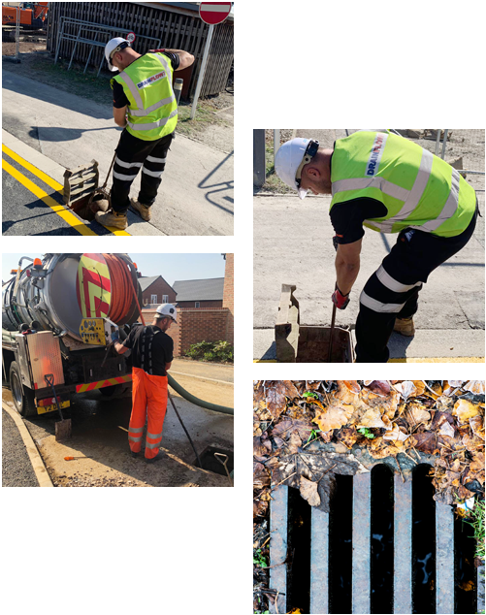
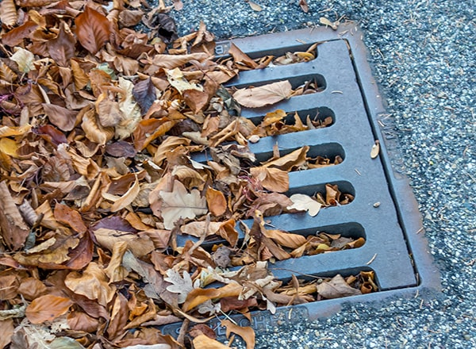
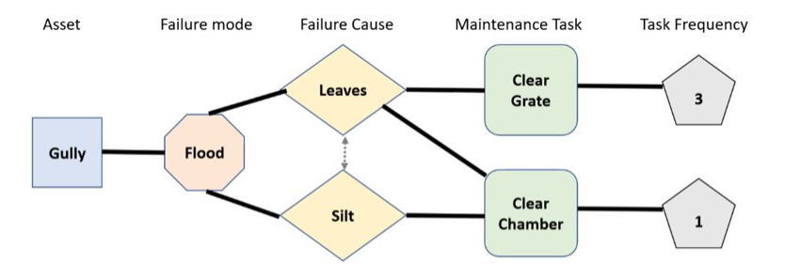
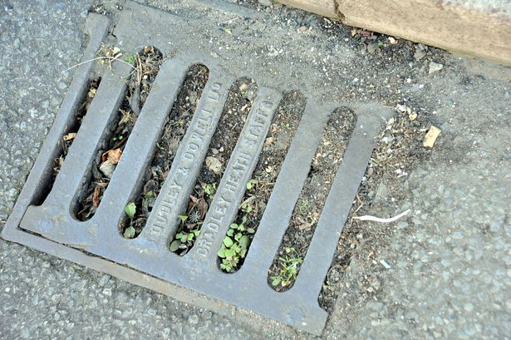
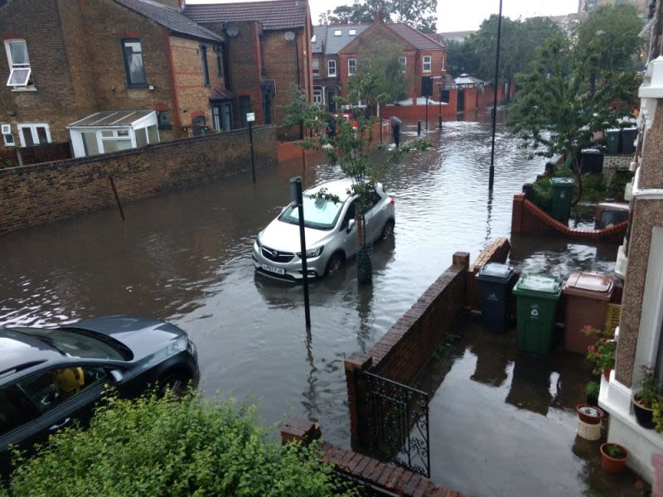
Project Introduction
Weather-induced Asset failure prediction
Hypothesis
Benefits

Slide 3
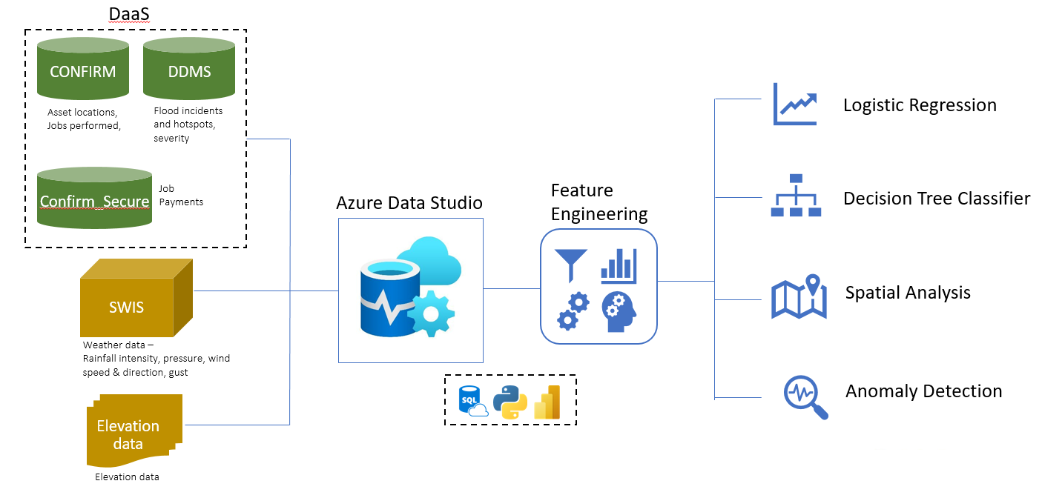
Understanding vs. Expectations
Data flow design
Methodology

Slide 4
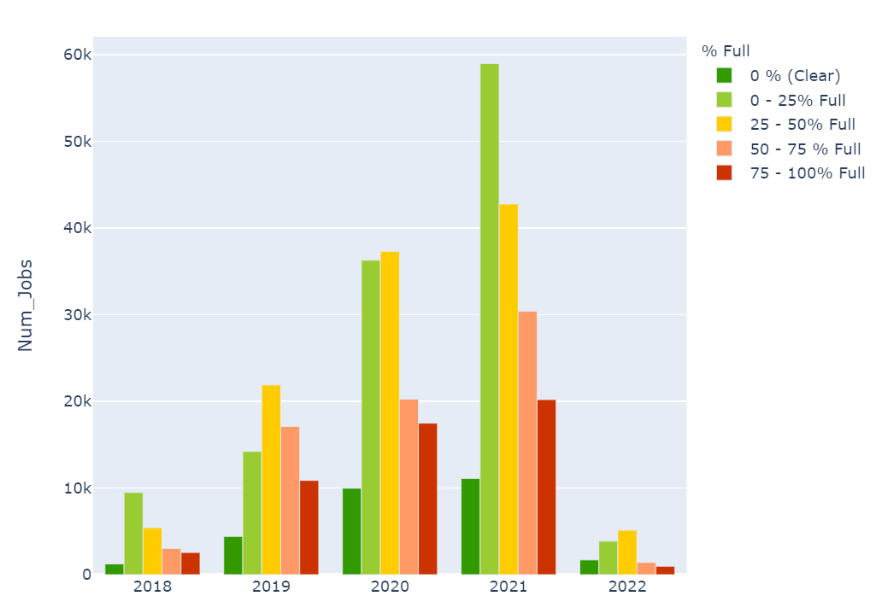
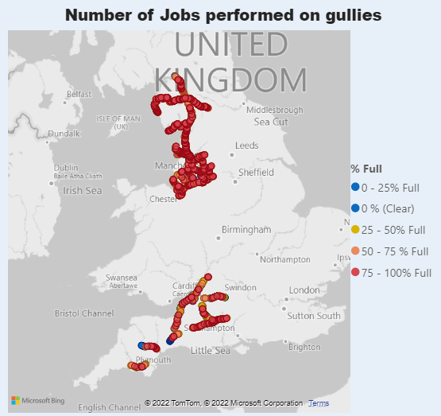
Data at a glance
Maintenance jobs on Gullies
Gully maintenance (2018-19) with weather information

Slide 5
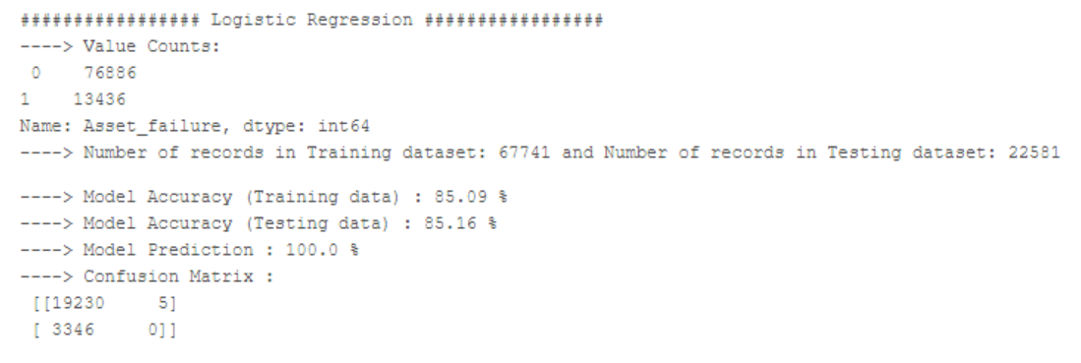
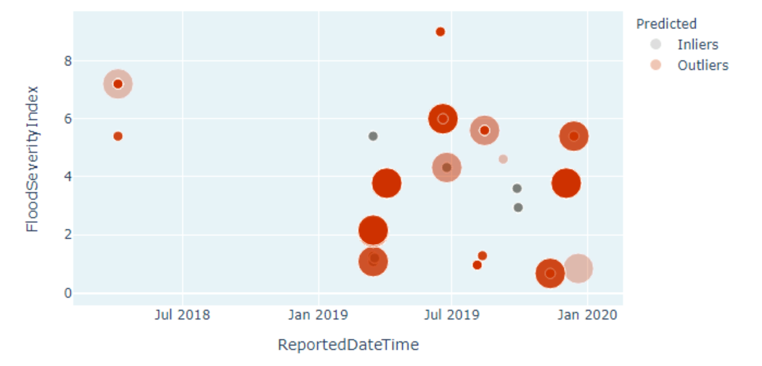
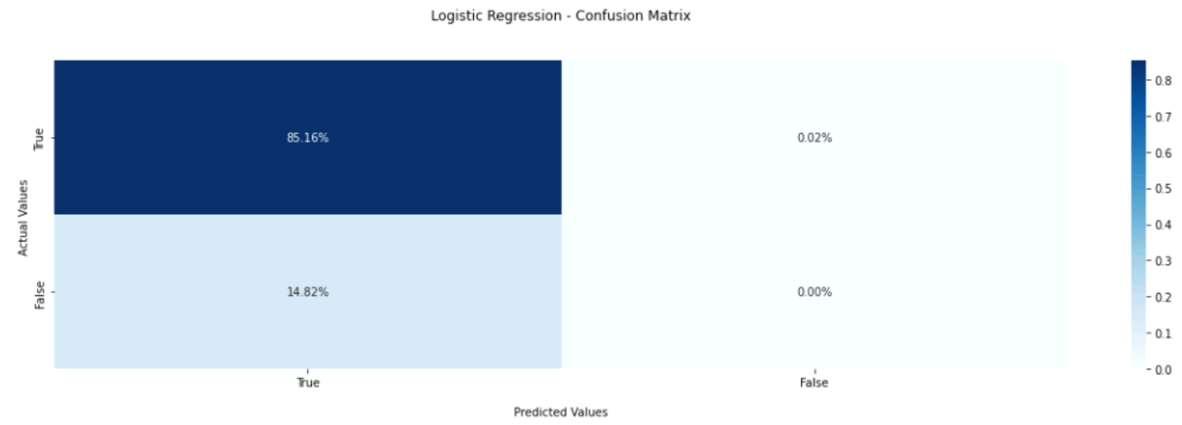
Project Outcomes
What worked?
Regression model
Anomaly Detection
What didn’t work?
Classification model

Slide 6
Learnings & Challenges
Technologies
Azure Data Studio
Azure DevOps
Ways of working
Agile methodology
DS Ideation and approach
Importance of Data Security
Challenges
Permissions
Keeping up with the meetings

Slide 7

Any questions?

Slide 8
End
Thank you for this opportunity !!

